Slide 1
Adversarial Search
Chapter 5.1-5.3
‹#›

Slide 2
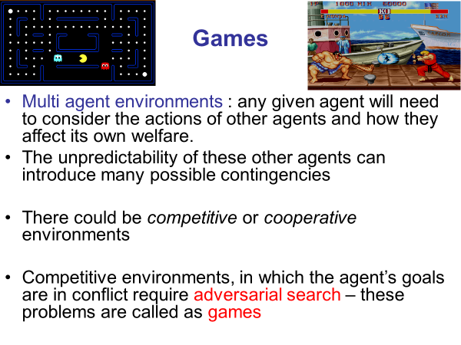
‹#›

Slide 3
Games vs. search problems
"Unpredictable" opponent 🡪 specifying a move for every possible opponent reply
Time limits 🡪 unlikely to find goal, must approximate
‹#›

Slide 4
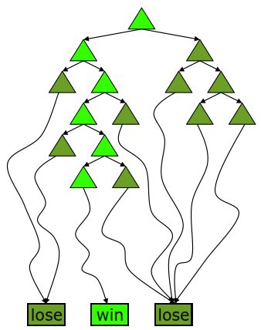
Deterministic Single-Player?
Deterministic, single player, perfect information:
Know the rules
Know what actions do
Know when you win
E.g. Freecell, 8-Puzzle, Rubik’s cube
… it’s just search!
Slight reinterpretation:
Each node stores a value: the best outcome it can reach
This is the maximal outcome of its children (the max value)
Note that we don’t have path sums as before (utilities at end)
After search, can pick move that leads to best node
Slide adapted from Macskassy

Slide 5
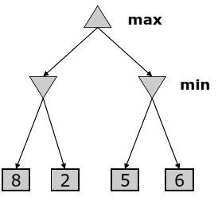
Deterministic Two-Player
E.g. tic-tac-toe, chess, checkers
Zero-sum games
One player maximizes result
The other minimizes result
Minimax search
A state-space search tree
Players alternate
Each layer, or ply, consists of a round of moves
Choose move to position with highest minimax value = best achievable utility against best play
Slide adapted from Macskassy

Slide 6
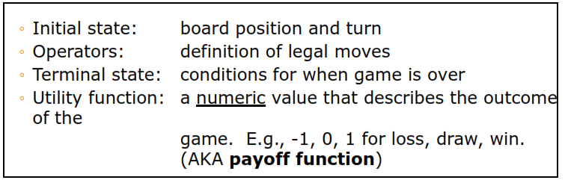
Two-player Games
A game formulated as a search problem:
Slide adapted from Macskassy

Slide 7
Game search
Game-playing programs developed by AI researchers since the beginning of the modern AI era
Programs playing chess, checkers, etc (1950s)
Specifics:
Sequences of player’s decisions we control
Decisions of other player(s) we do not control
Contingency problem: many possible opponent’s moves must be “covered” by the solution
Opponent’s behavior introduces uncertainty
Rational opponent – maximizes its own utility (payoff) function
‹#›

Slide 8
Game Search Problem
Problem formulation
Initial state: initial board position + whose move it is
Operators: legal moves a player can make
Goal (terminal test): game over?
Utility (payoff) function: measures the outcome of the game and its desirability
Search objective:
Find the sequence of player’s decisions (moves) maximizing its utility (payoff)
Consider the opponent’s moves and their utility
‹#›

Slide 9
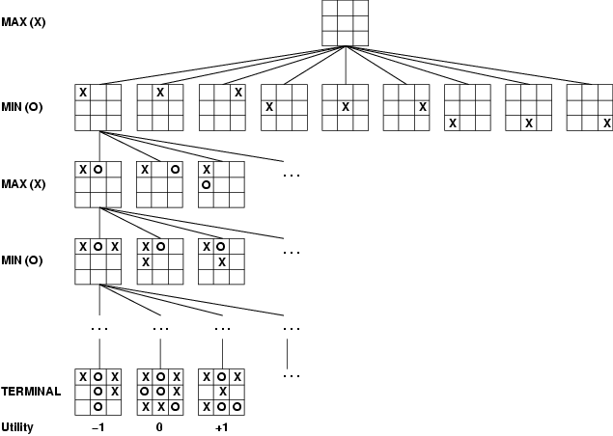
Game tree (2-player, deterministic, turns)
‹#›

Slide 10
Minimax Algorithm
How to deal with the contingency problem?
Assuming the opponent is always rational and always optimizes its behavior (opposite to us), we consider the best opponent’s response
Then the minimax algorithm determines the best move
The agent doesn't know what effect its actions will have
‹#›

Slide 11
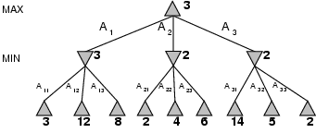
Minimax
Perfect play for deterministic games
Idea: choose move to position with highest minimax value = best achievable payoff against best play
E.g., 2-ply game: [will go through another eg in lecture]
‹#›

Slide 12
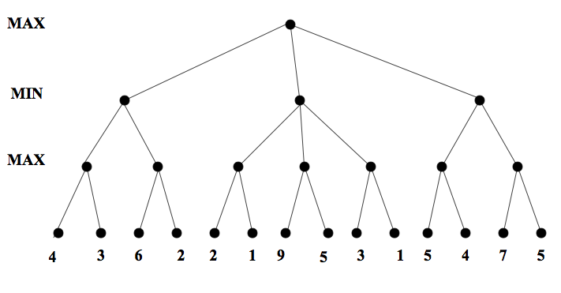
Minimax. Example 1
‹#›

Slide 13
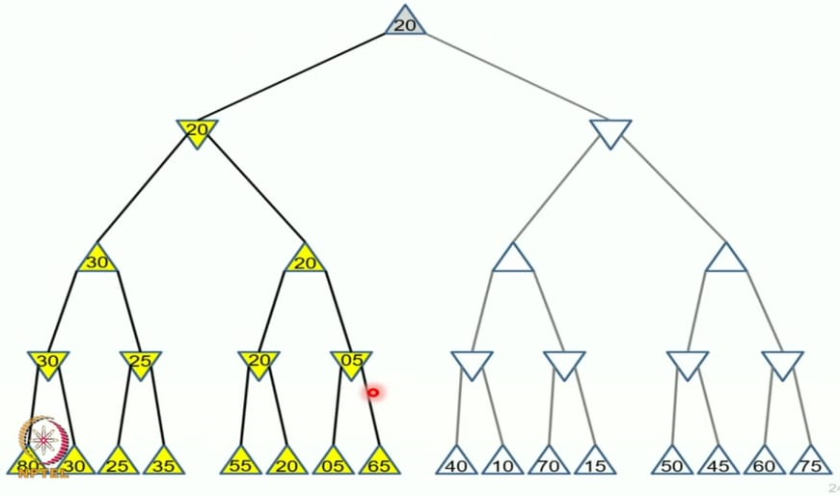
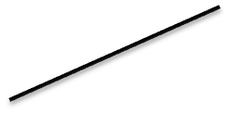
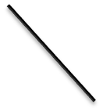


Ex 2
‹#›

Slide 14
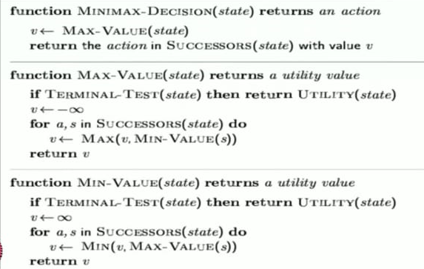
‹#›

Slide 15
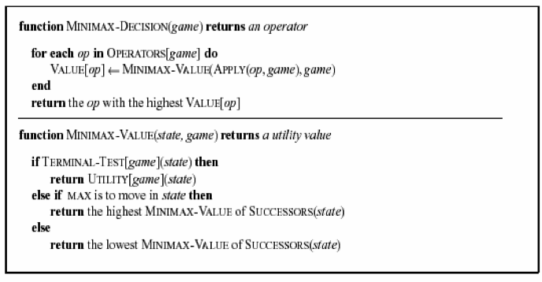
‹#›

Slide 16
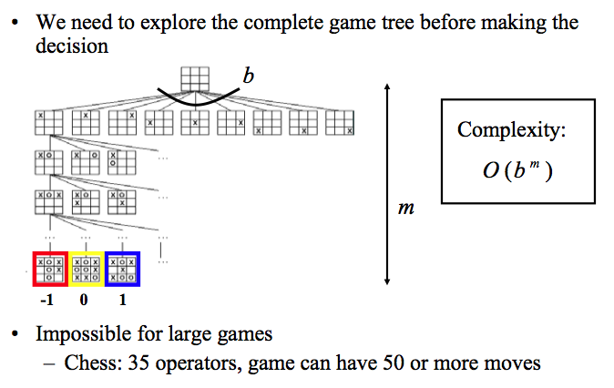
Complexity of the minimax algorithm
‹#›

Slide 17
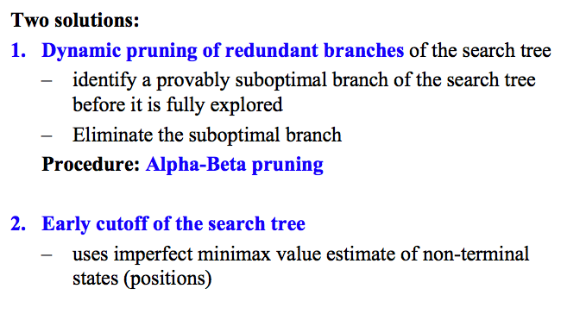
Solution to the complexity problem
‹#›

Slide 18
Alpha Beta Pruning
Some branches will never be played by rational players since they include sub-optimal decisions for either player
First, we will see the idea of Alpha Beta Pruning
Then, we’ll introduce the algorithm for minimax with alpha beta pruning, and go through the example again, showing the book-keeping it does as it goes along
‹#›

Slide 19
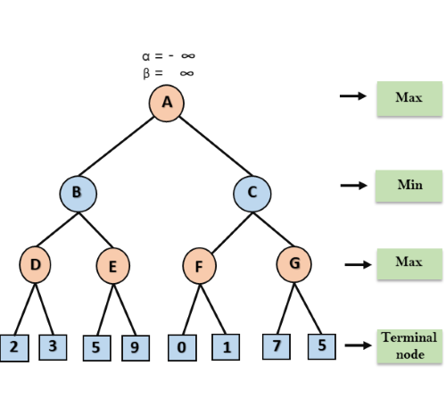
‹#›

Slide 20
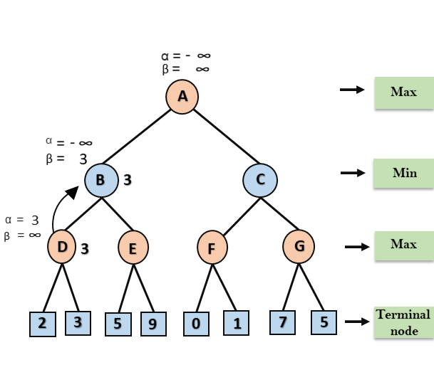
‹#›

Slide 21
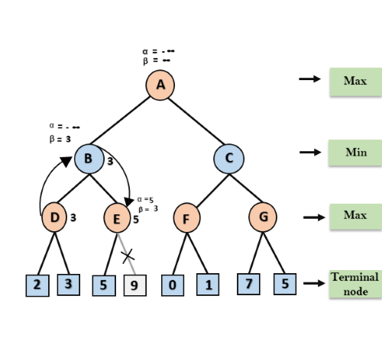
‹#›

Slide 22

‹#›

Slide 23
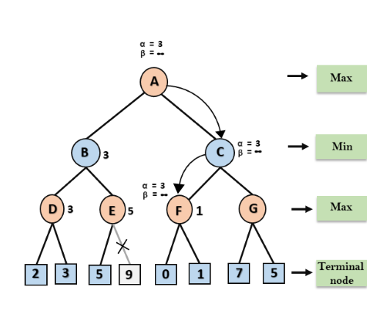
‹#›

Slide 24
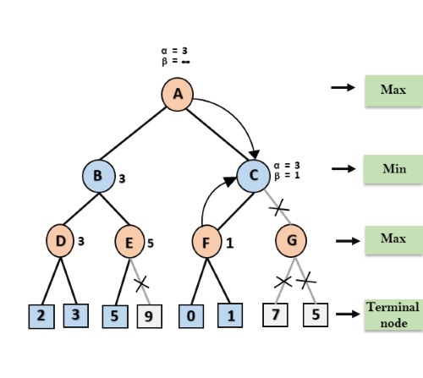
‹#›

Slide 25
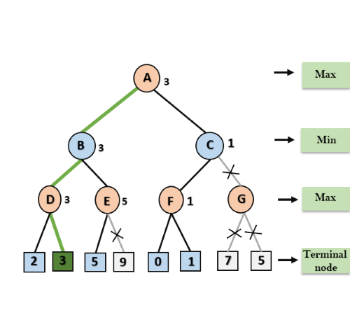
‹#›

Slide 26
Move Ordering in Alpha-Beta pruning:
Worst ordering: In some cases, alpha-beta pruning algorithm does not prune any of the leaves of the tree, and works exactly as minimax algorithm. In this case, it also consumes more time because of alpha-beta factors, such a move of pruning is called worst ordering. In this case, the best move occurs on the right side of the tree. The time complexity for such an order is O(b^{m}).
Ideal ordering: The ideal ordering for alpha-beta pruning occurs when lots of pruning happens in the tree, and best moves occur at the left side of the tree. We apply DFS hence it first search left of the tree and go deep twice as minimax algorithm in the same amount of time. Complexity in ideal ordering is O(b^{m/2}).
‹#›

Slide 27
α-β pruning
Alpha-beta search updates the values of α and β as it goes along and prunes the remaining branches at a node as soon as the value of the current node is known to be worse than the current α or β value for MAX or MIN, respectively.
The effectiveness of alpha-beta pruning is highly dependent on the order in which the successors are examined.

Slide 28
Properties of α-β
Pruning does not affect final result
Good move ordering improves effectiveness of pruning
With "perfect ordering," time complexity = O(b^{m/2})
🡪 doubles depth of search
A simple example of the value of reasoning about which computations are relevant (a form of metareasoning)

Slide 29
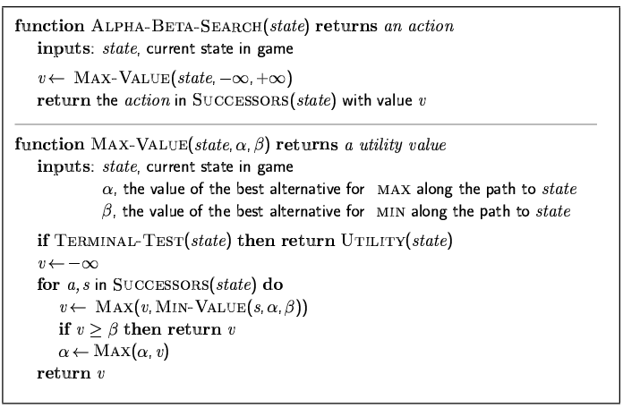
The α-β algorithm

Slide 30
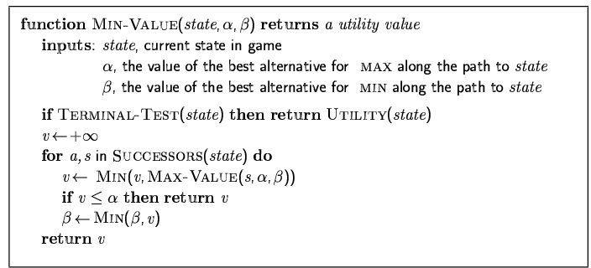
The α-β algorithm

Slide 31
Properties of α-β
Pruning does not affect final result
Good move ordering improves effectiveness of pruning
With "perfect ordering," time complexity = O(b^{m/2})
🡪 doubles depth of search
A simple example of the value of reasoning about which computations are relevant (a form of metareasoning)
‹#›

